Slide 1
Modeling & Statistics

Slide 2
What is modeling / model and data science?
Data science is the science of extracting useful information about the process from the data that is used by the process and generated by the process.
The information extracted reflects the way the various input attributes and output attribute/s interact or influence one another. This relation between the output and input attributes is represented as a model
All models represent real world processes. The process can be tangible or intangible. For e.g. modeling the performance of a car (mpg Vs wt) is the case of modeling a tangible process while modeling a stock exchange is the case of modeling an abstract process
For processes to be modeled, they need to be consistent in behavior. Given an input, the output every time should be similar if not the same
Model is a mathematical / rules-based representation of the entity / process. For e.g. the mpg = (-2.5X wt) – 26 is a mathematical representation of the behavior of cars while decision tree rules

Slide 3
COVID 19 Modeling

Slide 4
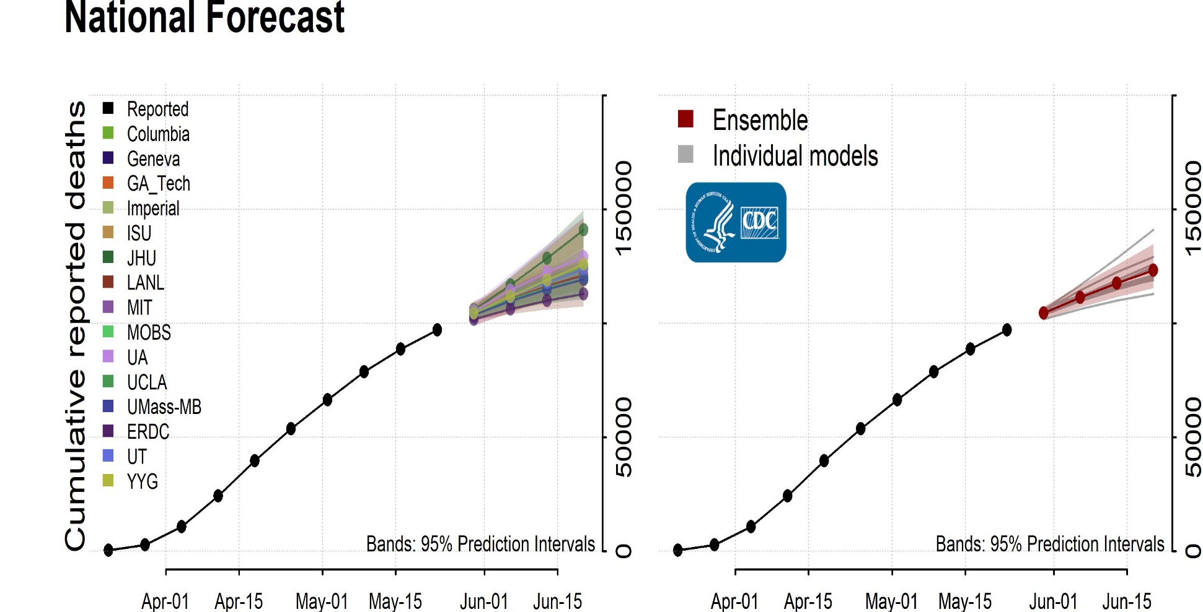
(USA)
Source:https://www.cdc.gov/coronavirus/2019-ncov/covid-data/forecasting-us.html

Slide 5
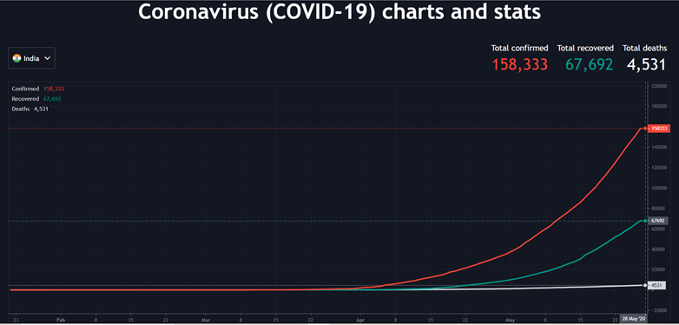
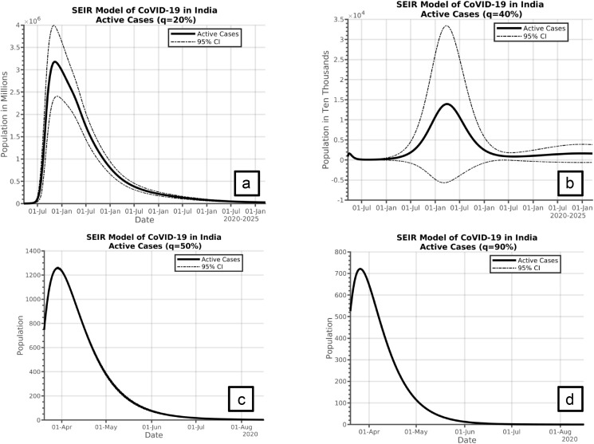
National Forecast (India)
Ref: https://www.ncbi.nlm.nih.gov/pmc/articles/PMC7126697/

Slide 6
https://www.pharmaceutical-technology.com/news/india-covid-19-coronavirus-updates-status-by-state/
Trends graphically - https://www.thehindu.com/data/covid-19-state-wise-tracker-for-coronavirus-cases-deaths-and-testing-rates/article31248444.ece
Statewise Zones - https://static.mygov.in/rest/s3fs-public/mygov_158831498053877021.pdf
Actionable insights Relaxation Guidelines –
Biggest challenge- how to establish reliability of the data. What if data is biased?

Slide 7
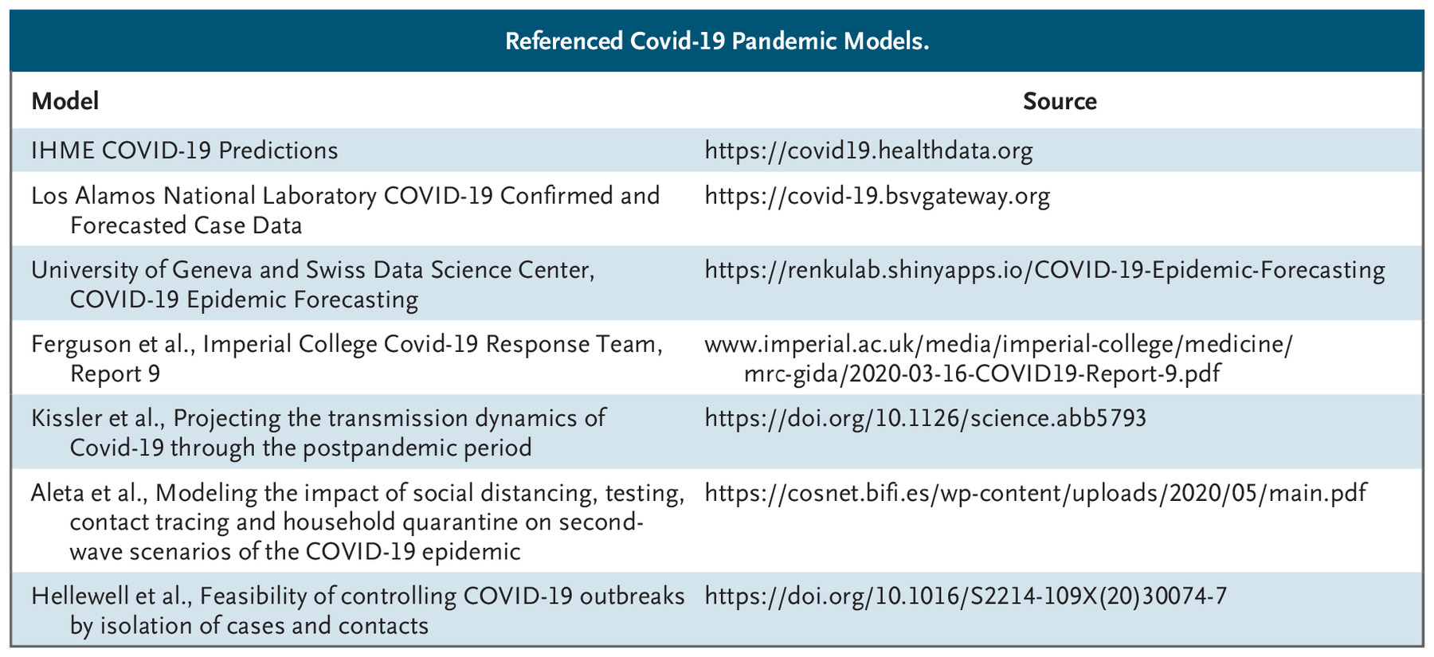
Source:https://www.nejm.org/doi/full/10.1056/NEJMp2016822

Slide 8
Model building and role of statistics
Four broad categories of actions in model building are –
Obtaining the data
Feature engineering
Building the model
Deploy models
Every step has some relevant questions that need to be answered by the data science team. In the reverse order of steps –
Deploy models - What performance is the model likely to give in production?
Building models – Is the apparent relation between the independent and target variables reliable? Or is it a statistical chance due to sampling
Feature Engineering / Selection – There are features that appear to be important and those that are not important, can we assume the same to be true in the population?
Obtain data – Is the data given for the project reliable? Can we trust the data to represent the production environment / the population?
To address all these questions, one needs hypothesis testing…. A core concept of inferential statistics and we need descriptive statistics for preparing the data for analytics i.e. during feature engineering stage.
Obtain Data
Feature Engineering/ Selection
Build models
Deploy models

Slide 9
Why do we need a model?
Models help us understand the hidden / internal workings / constructs of a process. For e.g.
modeling the behavior of the corona virus or
modeling the behavior of a customer help us understand they hidden rules customers follow in deciding whether to buy or not buy
Models also help us predict the future behavior of the entity or process. We can use the model to estimate how the entity or process is going to behave under certain specific situations. For e.g.
predicting number of ICU beds and PPE required to treat severe corona cases next month or
whether a customer is likely to churn in next six months given the data about the customer’s current consumption of goods and services

Slide 10
What is a process and what do we mean by process behavior?
A Process is a well defined set of steps (hidden or exposed) to convert a well defined set of inputs to well defined outputs
Well defined inputs and outputs means the central values, the spread of values that the inputs and outputs can take on various attributes is known apriori
For a process to be modeled, it has to be consistent in it’s behavior i.e. for a given input, give similar output all the times. Similar but may not be same
A random process i.e. a process which is inconsistent cannot be modeled. Such processes can generate random outputs given the inputs. Randomness has no useful information content which is a must for modeling
For modeling, the real world processes have to be consistent

Slide 11
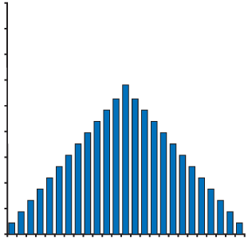
Consistent process
Inputs
Output
Well defined steps
-
0
+
Deviation from requirement
For given set of inputs, generates similar outputs. Outputs which are similar but not necessarily same. Some outputs are as per expectations some not but similar to expected
Output values vary due to random factors that come into play during the processing
Output values very different from expected are generated less frequently. Most of the output values are clustered close to the expected value

Slide 12
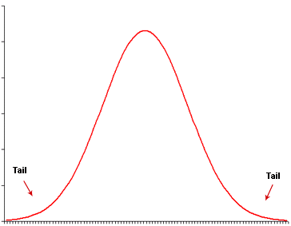
Distribution characteristics of a well defined stable process
The output metric will show a frequency distribution as shown below. Generate outputs with value close to the expected value (central values)
The output metric value strays more and more from the expected value with lesser frequency
The frequency distribution on a continuous scale can be transformed to a continuous distribution
Number of incidents of deviation from central value
= F( 1/ magnitude of deviation)

Slide 13
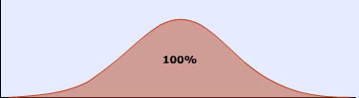
Area under the curve and probability
Distribution characteristics of a well defined stable process
Possible values of a parameter e.g. diameter
Area under the bell curve represents all possible (100%) values a parameter can take
Probability of output with value in the given range = Ratio of area of curve representing a particular range of values to overall area

Slide 14
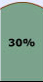
Area under the curve and probability
Distribution characteristics of a well defined stable process
V1
V2
Possible values of a given parameter e.g. diameter of a bolt up to infinity
Probability of producing output with values between V1 and V2 is area of the curve under between the two values / total area of the bell curve
What is the probability of producing output with
values less than V1
Values >v1
Values < v2
Value = v1 or v2
Note: normal distribution is one of the many possible distribution that may be used to represent a process. This is only for explanation

Slide 15
Distribution characteristics of a well defined stable process
The output of consistent processes will have a characteristic distribution i.e. a distribution with central value and spread (standard deviation)
The output distribution may be close to any of the statistical distributions such as Poisson, Weibull , Chi-square, Normal etc.

Slide 16
Why Statistics

Slide 17
Modelling process – universe, sample and bias
To create a model we need data. Data representing the input values and the output values generated by the process
In supervised learning methods we need both input and corresponding output values a.k.a labelled data
This data is obtained from the data already used and generated by the process in real life
The data is known as sample data. The source from where the data is extracted is called the universe
The model created will be good only if the sample is a true representation of the universe
But we have a problem…. A sample can never truly represent population

Slide 18

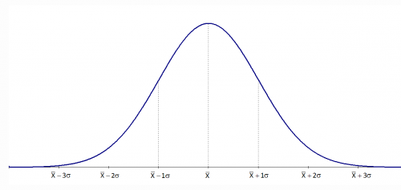
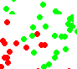

Modelling Errors – Variance error
Universe / Population
Time T1
Time T2
Sample / snapshot

Slide 19
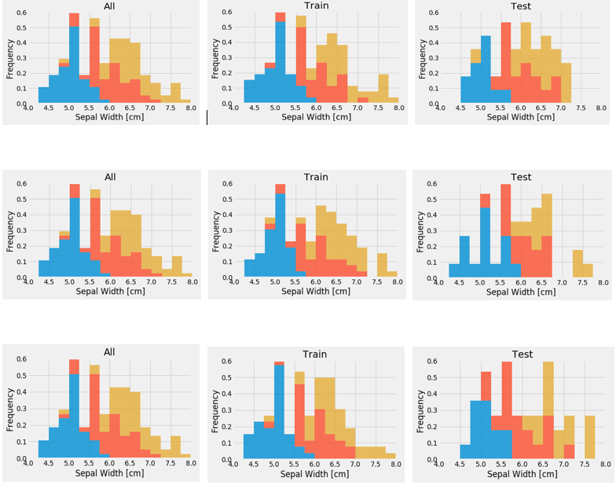
Modelling Errors Visaual demo of variance in training and test data
Sample Data (Analytics Base Table)
Three Random Training Sets From ABT
Three Random Test Sets From ABT

Slide 20
Establish reliability of data
Given that a sample can never be a true representative of the population, it becomes mandatory to establish reliability of the data that will be used for model building
Data is reliable when it can be statistically demonstrated
to have come from a stable consistent process
To be a good representative of the universe / production
Data can become unreliable due to various reasons
Concept drift i.e. gradual change in the behaviour of the process over time. As a result the data pulled out of archives no more represents behaviour of the current process
Sampling methodology introduces bias in the data through change in central values and spread of data. For e.g. Covid + is those who visited hospital or even those who are asymptomatic
The strategies used to address outliers and missing values can impact the central values and spread
We need statistics to establish reliability of the sample data. The required statistics can be categorized into descriptive and inferential statistics

Slide 21
Basic Statistics

Slide 22
Basic Statistics (a.k.a descriptive statistics)
Basic statistical analysis include
Measure of central values
Measure the spread around central values
Overall distribution shape
Descriptive analysis of the input and output attribute values helps understand the current state and behaviour of the process

Slide 23
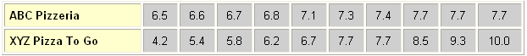
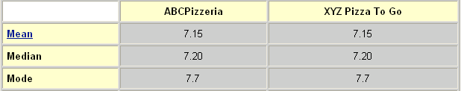
Descriptive statistics – central value and spread
Time to prepare the pizza
Image source: unknown
ABC pizzeria is much more consistent than XYZ pizza in terms of time to prepare
If you want to be sure about the amount of time you will need to get your lunch you will go to ABC Pizza
Going to XYZ Pizza will make one less sure about the time required to gather the lunch
However, if you are a risk taker, you may go to XYZ Pizza even when under time pressure as there is a chance of getting the lunch within 4.2 minutes. Saving a full 2+ minutes compared to ABC!
In short, central tendency alone is not important, one should know the spread also to take any decision

Slide 24
Descriptive statistics – Spread / Variance
Variance is measured as the average of sum of squared difference between each data point (represented by xi) and the mean represented by μ
N represents the number of data points (when number of data points is small (lesser than 30), we replace N with N-1 (degrees of freedom)
Sum of difference between each data point and mean will always be zero. Hence square the difference and sum up the squared term as shown below
N
Σ (x_{i} - μ)²
¡=1
----------
N

Slide 25
Descriptive statistics - Standard Deviation
Interpreting variance ( a squared term) is not intuitive. Instead we under root it to get Standard Deviation which has the same units as the variable
Standard deviation, is a measure of average spread i.e. on an average what is the difference between any data point and the central value of the variable
Continuing with the previous example, standard deviation is square root of 106.28 = 10.30
When the number of data points is small (less than 30), we replace N with N-1(degrees of freedom) in the denominator
√
N
Σ (x_{i} - μ)²
¡=1
----------
N

Slide 26
Descriptive statistics - Range
Range is a measure of the difference between the max and the min values of any attribute
Range gives a first hand and quick view of the spread in the data
However, range will easily get distorted by outliers. Hence, it is not a reliable metric
Outliers will distort the central values (mean and median). Central values are expected values, an important characteristic of the process generating the data
Outlier
1 2 3 4 5 6 7 8 9
Mean = 71/18 = 3.9
Median = 4
Excluding outlier
Mean = 62/17 = 3.6
Median = 4
Range = 9 – 1 = 8
Excluding outlier
Range = 6 – 1 = 5

Slide 27
Descriptive statistics - Quartiles
Quartile is a measure of dispersion of data around the median as central value
Median, which divides the data points into two equal half is also known as Quartile 2 or Q2
Quartile 1 or Q1 divides the values between minimum and Q2 into two equal half. In other words Q1 is that value which has 25% values below it and rest above
Quartile 3 or Q3 divides the data points between Q2 and max into two halves i.e. it has 75% of the values below it and 25% above
The gap between Q3 and Q2 = 1 units while distance from Q2 to Q1 = 1 unit. The body of the distribution is intact
Distance between min and Q1 is 2 units and distance from Q3 to max is 1 unit. Left side tail is longer the right side tail. Indicates a skew on left side
Overall a slight asymmetry is noticed in the distribution
1 2 3 4 5 6 7 8 9
Q1 = 3
Median (Q2) = 4
Q3 = 5

Slide 28
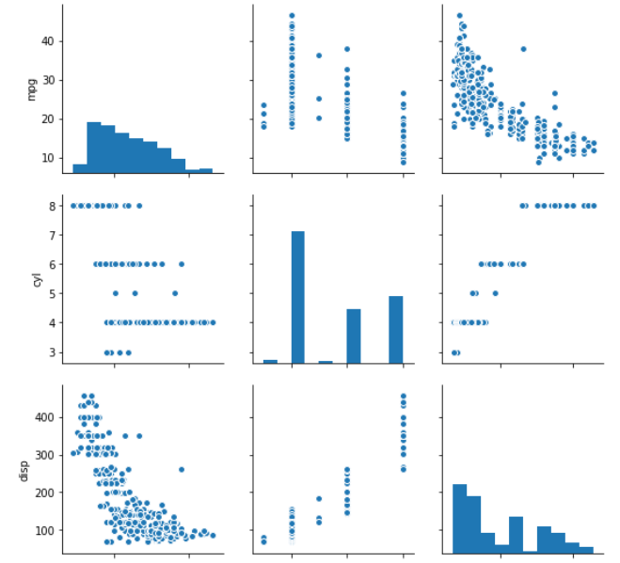
Descriptive statistics – Pairplot analysis
Pairplot is a square matrix. Each row and each column in the matrix is one attribute in the dataframe.
The relation between the attributes (how they influence one another) is reflected in the scatter plot
When the row number and column number in the matrix are same, we are comparing an attribute with itself. Scatter plot will not make sense. Instead, we get histogram by default
Histogram helps visualize the distribution characteristics on each attribute.
Scatter plot reflects how one attribute interacts with other. Is it a strong or weak relationship, is it positive or negative relationship or, is there no relationship
Can visualize outlier / leverage points (shown in red circle) which would not stand out in univariate analysis
mpg
cyl
disp

Slide 29
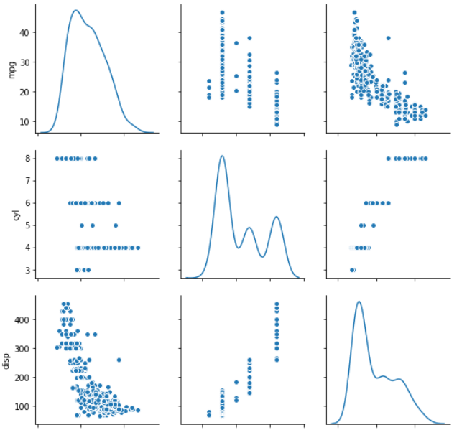
Descriptive statistics – PairPlot analysis
Using KDE in pairplot, we can identify potential clusters in the attributes
Presence of multiple peaks (red circle) on an attribute that is not the target (predicted column) may be due to mix up of gaussians
Mix up of gaussians will result in long tails and less reliable central values.
Less reliable the central values, less reliable the models that hinge on the central values
One can analyze the attributes and their relations to the target variables by each gaussian for richer insights
mpg
cyl
disp
Cars-mpg dataset
Predict mpg based on other attributes

Slide 30
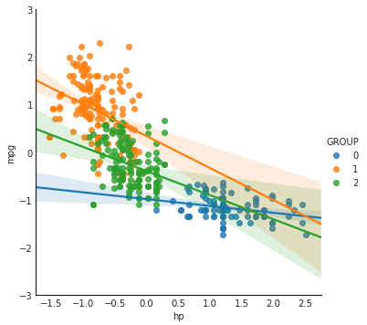
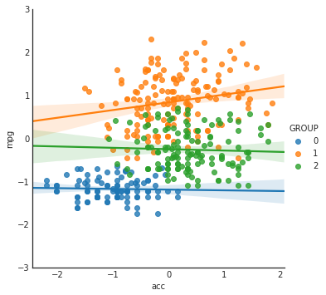
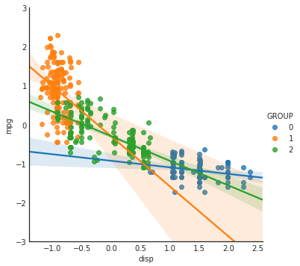
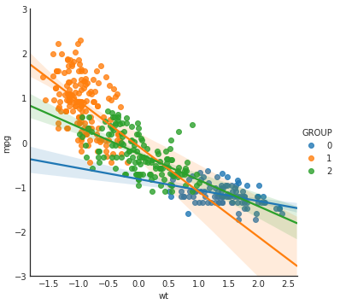
Descriptive statistics – PairPlot analysis
One can analyze the attributes and their relations to the target variables by each gaussian for richer insights
In the figures, each gaussian is marked by different color
Orange color represents small cars (low horsepower, less displacement and weight) while blue represents large cars
Looks like this data consists of three types of cars (small, mid-size and large cars)
The strength of relation between mpg (target column) and the various attributes is different for the different types of cars
Displacement seems to be strong predictor of mpg for mid size and large cars but not so for small cars!
Does it make sense to build one single model representing all the cars when their characteristics are different?
Fig A
Fig B
Fig C
Fig D
Cars-mpg dataset
Predict mpg based on other attributes

Slide 31
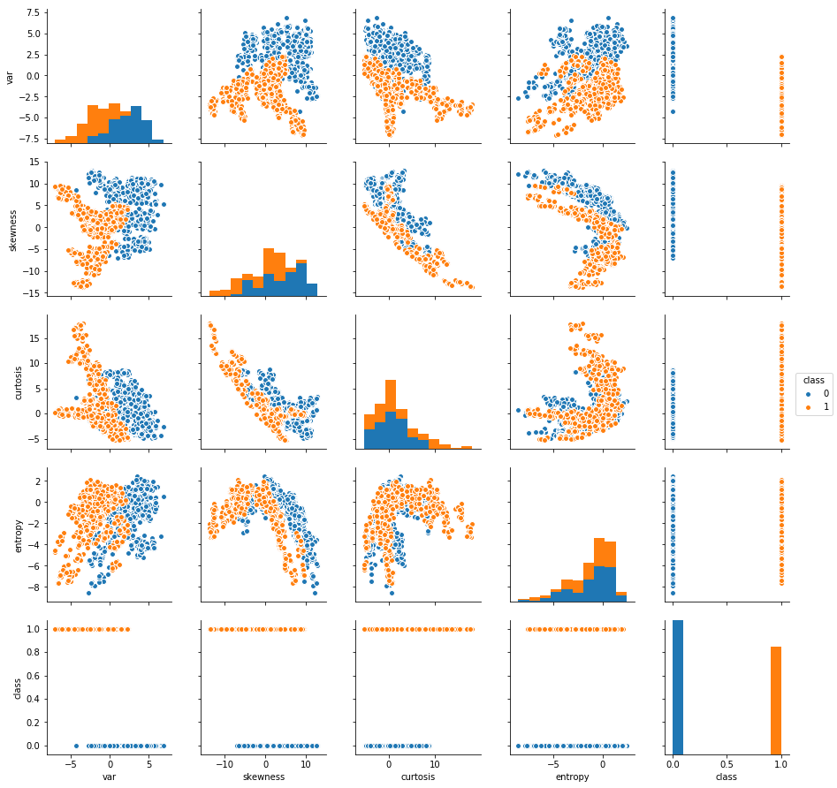
Descriptive statistics – PairPlot analysis
In case of classification problems, we will naturally find as many peaks as the classes in the target column. This is not the same as mix of multi-gaussians on attributes.
In the figure, we see in the last column, last row is the target variable “class” which is binary (blue – real notes, orange – fake notes)
Pairplot helps us to identify attributes that can help us separate these two classes.
In the last row, class Vs attributes – Higher value of curtosis is only for fake
In the last row, first column – higher values of ‘var’ is only for the real notes
For rest of the data points, the probability of belonging to one class or other changes gradually in “skewness”
All these distribution characteristics together help build good models with high score in classification on this dataset
The distribution of the two classes and the shape of the boundaries may also help guess which algorithms may do well and which not
Decision tree being axis parallel algorithm may not do as well as a logistic or KNN in this case
data_banknote_authentication
Classify notes into real or fake

Slide 32
Descriptive statistics – Lab 1
Run descriptive statistics on wines dataset and discuss your findings –
import pandas as pd
wine_df = pd.read_csv('d:\\ML_Data\\wine.csv', names = ["Cultivator", "Alchol", "Malic_Acid", "Ash", "Alcalinity_of_Ash", "Magnesium", "Total_phenols", "Falvanoids", "Nonflavanoid_phenols", "Proanthocyanins", "Color_intensity", "Hue", "OD280", "Proline"])
wine_df.describe().transpose()
 | count | mean | std | min | 25% | 50% | 75% | max
Cultivator | 178 | 1.938202 | 0.775035 | 1 | 1 | 2 | 3 | 3
Alchol | 178 | 13.00062 | 0.811827 | 11.03 | 12.3625 | 13.05 | 13.6775 | 14.83
Malic_Acid | 178 | 2.336348 | 1.117146 | 0.74 | 1.6025 | 1.865 | 3.0825 | 5.8
Ash | 178 | 2.366517 | 0.274344 | 1.36 | 2.21 | 2.36 | 2.5575 | 3.23
AlcalinityAsh | 178 | 19.49494 | 3.339564 | 10.6 | 17.2 | 19.5 | 21.5 | 30
Magnesium | 178 | 99.74157 | 14.28248 | 70 | 88 | 98 | 107 | 162
Total_phenols | 178 | 2.295112 | 0.625851 | 0.98 | 1.7425 | 2.355 | 2.8 | 3.88
Falvanoids | 178 | 2.02927 | 0.998859 | 0.34 | 1.205 | 2.135 | 2.875 | 5.08
Nonflavanoid | 178 | 0.361854 | 0.124453 | 0.13 | 0.27 | 0.34 | 0.4375 | 0.66
Proanthocyanins | 178 | 1.590899 | 0.572359 | 0.41 | 1.25 | 1.555 | 1.95 | 3.58
Color_intensity | 178 | 5.05809 | 2.318286 | 1.28 | 3.22 | 4.69 | 6.2 | 13
Hue | 178 | 0.957449 | 0.228572 | 0.48 | 0.7825 | 0.965 | 1.12 | 1.71
OD280 | 178 | 2.611685 | 0.70999 | 1.27 | 1.9375 | 2.78 | 3.17 | 4
Proline | 178 | 746.8933 | 314.9075 | 278 | 500.5 | 673.5 | 985 | 1680

Slide 33
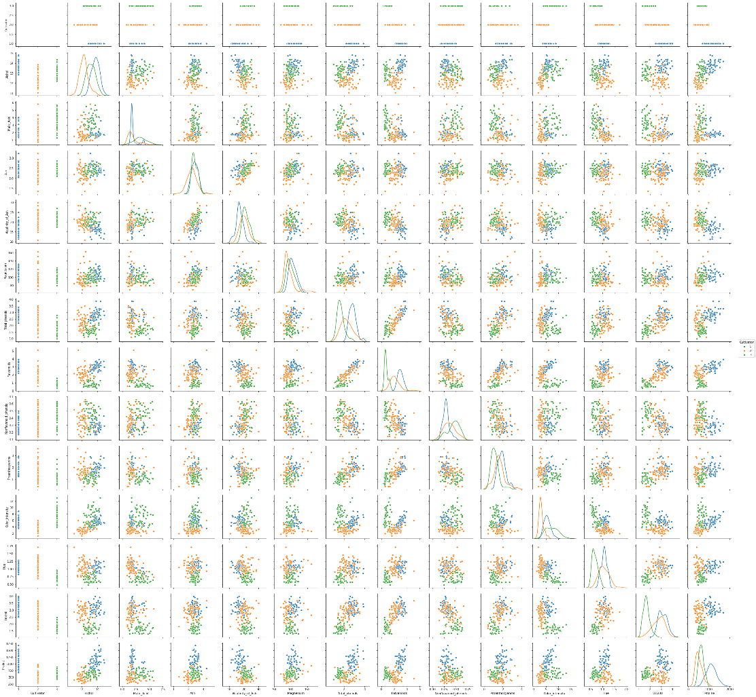
Descriptive statistics (univariate / bi-variate analysis
Pair plot –
import seaborn as sns
sns.pairplot(wine_df, hue='Cultivator' , diag_kind = 'kde')

Slide 34
Descriptive Statistics Findings
Distribution characteristics of the attributes (univariate analysis)
Sample statistics including central values (mean, median)
Spread inform of inter quartile range, distance of central values from quartiles
Skews in the distributions, long tails, potential outliers, missing values
Mix of gaussians
Bi-variate analysis helps understand-
Degree of interactions between the variables
Distribution patterns of classes (are they linearly separable)
Presence of hidden outliers , leverage points
Identify potential good attributes
May help in choice of algorithms to build models on
Together, the univariate and bi-variate analysis give an insight into the process that generated the data and form the core of descriptive statistics

Slide 35
Probability, Probability Distribution And Modeling

Slide 36
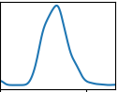
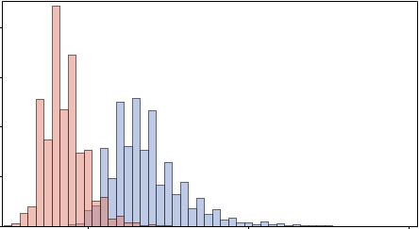
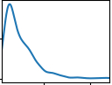
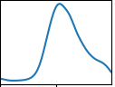
Well defined stable process
Inputs
Output
Well defined steps
Distribution of the values of inputs and output of all well defined processes are characterized by a distribution shape with central values (a.k.a expected values) and standard deviation (spread of the values around the central values)
The ML algorithm will take into account the distribution on inputs and output and represents their relationship as a model

Slide 37
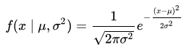
Probability and distributions
Normal Distribution – also called the Gaussian distribution
Is an important family of continuous probability distributions.
Each member of the family may be defined by two parameters, the mean and the variance
Standard normal distribution is the normal distribution with a mean of zero and variance of 1
Carl Friedrich Gauss used it extensively for his astronomical studies and discovered the equation (statistical model). The function is also called bell curve.
Apparently this type of distribution is common in nature. Hence the word “Normal” is also used for this distribution. It has following characteristics –
The mean, median and mode of the distribution coincide.
The distribution curve is symmetric bell-shaped about the line x = μ.
The total area under the curve is 1
Expected value of x = μ , variance =
Most of the Scikit_Learn parametric machine learning algorithms assume the data on the individual attributes with continuous values are normally distributed

Slide 38
Probability and distributions
Normal curve – Z scores
- ∞
a
x
y
+ ∞
µ = 5
8
- 6σ
- 5σ
- 4σ
- 3σ
- 2σ
- 1σ
+ 1σ
+ 2σ
+ 3σ
+ 4σ
+ 5σ
+ 6σ
Z score is the distance of a data point in terms of standard deviation
For e.g. “x” is +1.5σ from the mean, z = +1.5
“y” is +2.5σ from the mean, z = +2.5
“a” is -2.5σ from the mean, z = -2.5
Values with larger magnitude Z score occur less and less frequently

Slide 39
Probability and distributions
Normal distributions have the following characteristics:
Approximately 68% of the values fall between the mean and one standard deviation (in either direction)
Approximately 95% of the values fall between the mean and two standard deviations (in either direction)
Approximately 99.9% of the values fall between the mean and three standard deviations (in either direction)
Normal curve – Z score and area of the curve
- ∞
+ ∞
µ
- 1σ
+ 1σ
68.26%
- 2σ
+ 2σ
95.46%
- 3σ
99.73%
+ 3σ
- 4σ
99.9937%
+ 4σ
- 5σ
+ 5σ
99.99943%
- 6σ
99.999998%
+ 6σ

Slide 40
Normal distribution with area under the curve as probability
V1
V2
Possible values of a given parameter e.g. diameter of a bolt up to infinity
Probability of producing output with values between V1 and V2 is area of the curve under between the two values / total area of the bell curve
What is the probability of producing output with
values less than V1
Values >v1
Values < v2
Value = v1 or v2
Note: normal distribution is one of the many possible distribution that may be used to represent a process. This is only for explanation

Slide 41
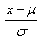
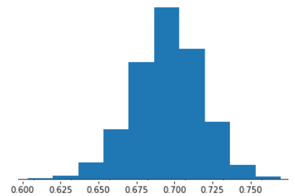
Probability and distributions
Let the accuracy scores of a model executed using bootstrapping constitute a normal distribution with mean of 72% and standard deviation of 6 %. What is the probability that the model will give a score greater than 75% in production environment?
Let random variable X corresponds to the accuracy of the model in production.
We want to calculate P(X > 75%).
Calculate the Z-score of 75 % accuracy, = = (75 – 72) / 6 = 0.5
The mean μ of the distribution is 72 % and the standard deviation σ is 6%
P(X > 75%) = 1 – P(X<=75) i.e. P(Z <= 0.5). From the distribution table = .69
Hence P(X>75%) = 1 - .69 = .31

Slide 42
Joint & Conditional Probabilities

Slide 43
Joint & Conditional Probabilities
Joint Probability – is the probability of multiple events occurring together (we are not talking of causality here i.e. one event leads to another). For e.g.
probability of drawing a king from a deck of cards is 4/52
Probability of drawing a red colour card from a deck of cards is 26/52
Probability of drawing a red colour king = 2 / 52
Conditional Probability – it is the probability that an event has occurred (not yet observed) given another event has occurred. For e.g.
given the card drawn is red (an event has occurred)
what is the probability it is a king (event not yet observed)?
Since the card is red, there are 26 likely values for red
Of these 26 possible values we are interested in king which is 2 (king of diamonds and heart)
Thus the conditional probability that the card is a king given red card is 2 /26
Compare this with joint probability of red king (2/52).
Given an event has occurred, it increases the probability of the other event

Slide 44
Joint & Conditional Probabilities
Imagine you represent all the flight experience you had till date as the blue area in a mathematical space. The dimensions of the boxes and circles are immaterial
Of these experiences, 20% of the time you experienced flight delay
Flight data
Flight data
A 100%
80 %
A 20%

Slide 45
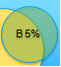
Joint & Conditional Probabilities
P(flight delay given fog) = P (A n B) / P(B)
Flight delayed no fog
Fog but no flight delay
Flight data
B 5%
80 %
A 20%
(A n B) = flight delay and fog
Lesser the overlap, lesser the occurrences of flight delay and fog
More the overlap, more the occurrences of flight delay and fog
P(A| B) = P(A n B) / P(B) → eq 1
P(A n B) = P(A|B) * P(B) (rearranging the terms in eq 1)
Also, P(A n B) = P(B n A) = P(B|A) * P(A)
Therefore eq 1 - P(A|B) = P(B|A) * P(A) / P(B)

Slide 46
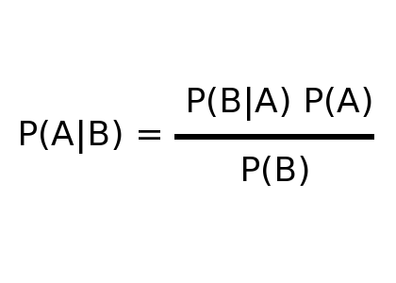
Naïve Bayes Classifier -
The relationship between dependent events is depicted using Bayes theorem
Probability of event A given that event B has occurred (fog has formed) depends on
Apriori probability of fog occurring whenever there was flight delay – P (B/A)
Apriori probability of flight delay P(A) which is 20% in the example
Apriori probability of flight facing fog P(B) which is 5% in the example
When it is a matter of deciding the class of an output such as whether flight will get delayed or not, we calculate P(A/B) and P(!A/B), compare which is higher. Since in both the denominator is P(B), it is ignored as it has no influence on which class will it be
However, to calculate the updated probability of a class, denominator P(B) is required
Flight data
Likelihood
Prior prob
B 5%
Posterior
Evidence
80 %
A 20%

Slide 47
Naïve Bayes Classifier -
The following two tables reflect the apriori probabilities of the events A and B. Probabilities based on past data of 100 points
In the likelihood table (T2) reveals that P(fog = Yes / flight delayed) = 4/20 = .20 indicating that likelihood is 20 percent that a flight will be delayed given fog
P( ) => P(flight delay | fog) = P(fog / flight delay) * P(flight delay)
P(flight delay | fog) = ( (4/20) * (20 / 100) ) = .04 (maximal probability) (no need to divide by P(B), probability of fog, as it is a constant. This is Naïve Bayes probability.
Joint probability - P( ) = ((20 / 100) * (5/100)) = .01
T1 | FOG
Frequency | Yes | No | Total
Flight delayed | 4 | 16 | 20
Not Delayed | 1 | 79 | 80
Total | 5 | 95 | 100
T2 | FOG
Likelihood | Yes | No | Total
Flight delayed | 4 / 20 | 16 / 20 | 20
Not Delayed | 1 / 80 | 79 /80 | 80
Total | 5 / 100 | 95 / 100 | 100

Slide 48
Naïve Bayes Classifier -
Suppose there are multiple factors that could lead to flight delay (as shown in the likelihood table below)
Probability that the flight will be delayed, given that Fog = Yes, Technical Snag = No :
Treat the event of flight delay as A
Treat the joint event (Fog=Yes, Technical Snag=No) as B
P ( A | B) = P(flight delay / Fog n ! Technical Snag) =
P(B | A) * P(A) divided by P(B)
( P(Fog n ! Technical Snag) | flight delay) * P(flight delay) ) / P(Fog n ! Technical Snag)
( because of the naïve assumption of independence of features, this can be expressed as -
P(Fog n ! Technical Snag) | flight delay) = P(Fog | flight delay) * P(!Technical snag | flight delay)
T2 | FOG |  | Technical Snag |  | Pilot Fatigue |  | Passenger
Likelihood | Yes | No | Yes | No | Yes | No | Yes | No | Total
Flight delayed | 4 / 20 | 16 / 20 | 10/20 | 10/20 | 0/20 | 20/20 | 12/20 | 8/20 | 20
Not Delayed | 1 / 80 | 79 /80 | 14/80 | 66 /80 | 8/80 | 71/80 | 23/80 | 57/80 | 80
Total | 5 / 100 | 95 / 100 | 24/100 | 76/100 | 8/100 | 91/100 | 35/100 | 65/100 | 100

Slide 49
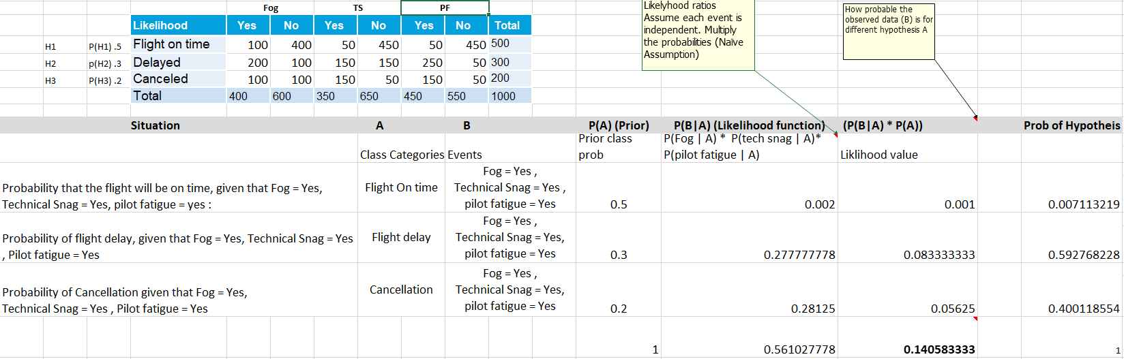
Naïve Bayes Classifier -

Slide 50
Naïve Bayes Classifier -
Note: - | Likelihood function is not a density function hence it will not total to 1
 | Probability of hypothesis i.e. probability of flight delay , probability of flight on time, probability of cancellation is found by dividing P(B|A) *P(A) by the sum of the column O
 | The entries in column O show how much more likely a given hypothesis is compared to other. For e.g. how more likely is the flight delay compared to flight on time - 0.083 / 0.001
 | For classification we need only this comparison and that hypothesis that is more likely than others is the class predicted
 | If we want to express the output as pure probability, then divide each likelihood value with the sum of all likelihood values
 | The P(B) in the denominator of Bayes equation is called the normalization constant and is used to convert the likelihood values into probabilities such that the left side of the equation P(A|B) sums up to 1 for the different hypothesis together

Slide 51
Naïve Bayes Classifier -
Advantages -
Simple , Fast in processing and effective
Does well with noisy data and missing data
Requires few examples for training (assuming the data set is a true representative of the population)
Easy to obtain estimated probability for a prediction
Dis-advantages -
Relies on and often incorrect assumption of independent features
Not ideal for data sets with large number of numerical attributes
Estimated probabilities are less reliable in practice than predicted classes
If rare predictor value is not captured in the ** training set but appears in the test set the probability calculation will be incorrect
** For e.g. input record has fog=“yes”, Technical snag = “yes”, Pilot Fatigue = “Yes” and passenger delay = “yes” .If this combination is not in the training set for delayed flights in the past then the probability calculation in step “a” on previous slide will become 0!

